Slide 1
2023.01.11 – Update
Interface to define cell contours
A toolbox for quantifying the cytoskeleton

Slide 2
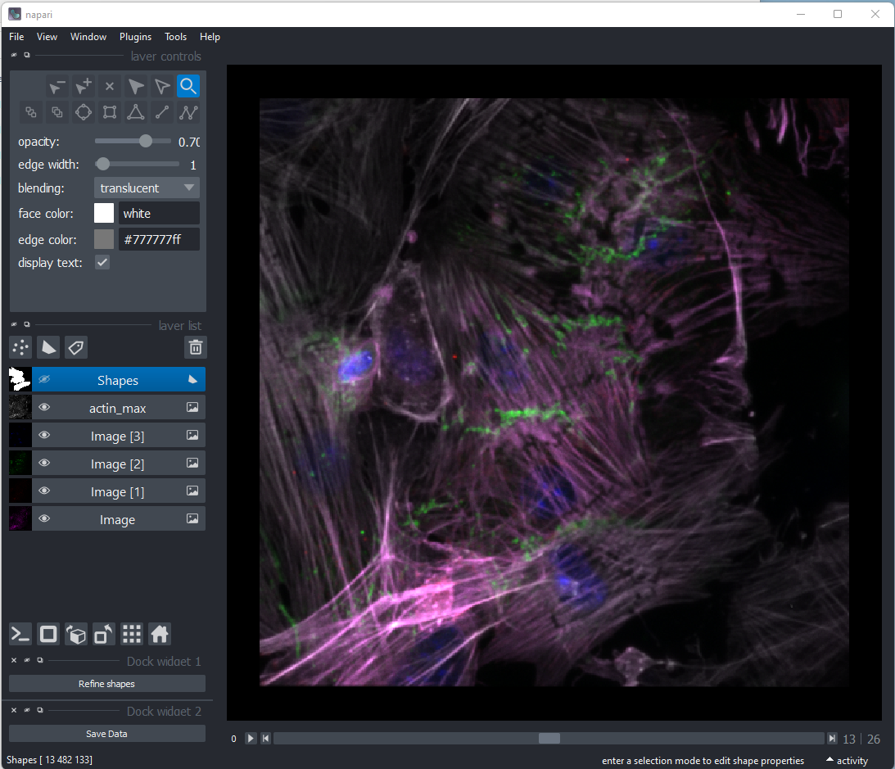
Based on 3D confocal stacks (actin+paxillin+plakoglobin+DAPI) it’s not possible to segment cells automatically.
Therefore, we created an interface to manually define the contours of the cells.

Slide 3
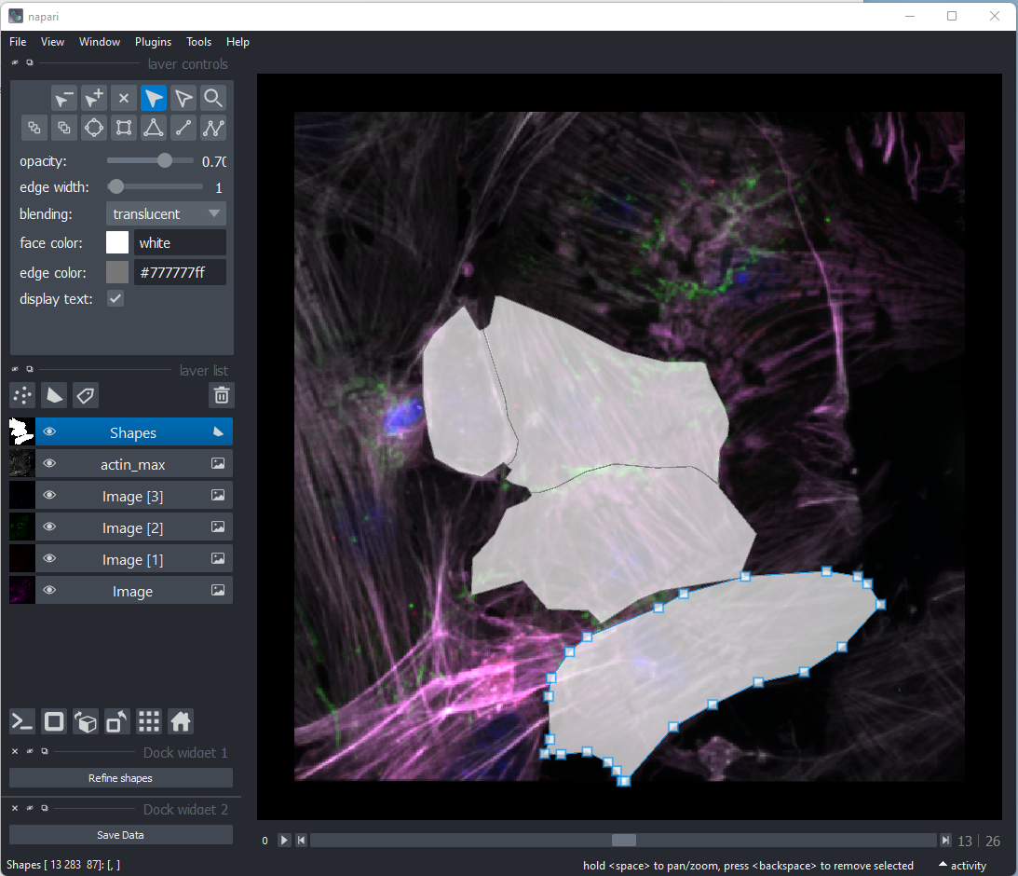
A user is creating contours by defining vertices of the polygons.

Slide 4
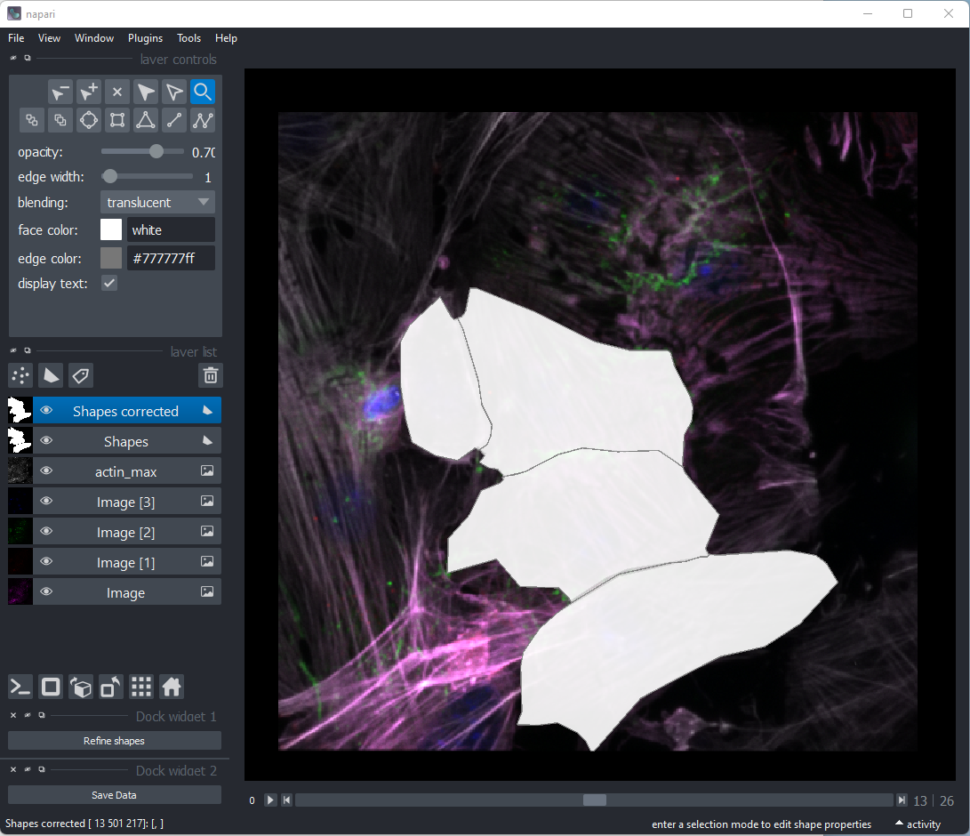
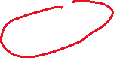

As the cells form tight monolayers we added an option of refining the contours by dividing and incorporating gaps between the neighbouring cells.

Slide 5
Based on the defined contours, quantification of the signals can be performed fully automatically.
3
4
2
1

Slide 6
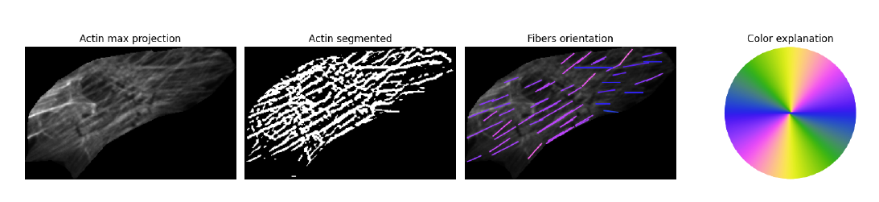
Actin segmentation
Above you can see an example of actin segmentation. Actin fibers are detected in a 3D volume and the straight-line segments are detected in 2D max projections in order to define a dominant actin orientation in a cell.
This approach needs further refinement to define local arrangements of actin fibers. The more advanced analysis will be feasible with 100x or SIM images.

Slide 7
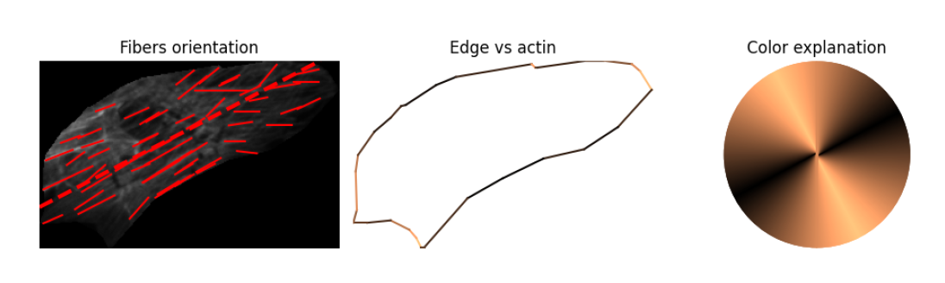
Edge vs actin orientation
By defining the main flow of actin we can calculate which edges of a cell are parallel and perpendicular to the dominant actin direction.

Slide 8
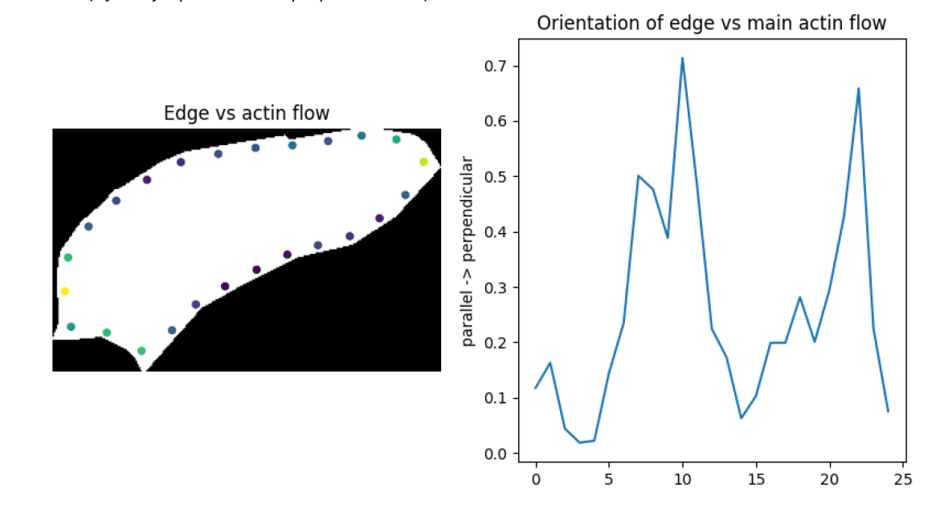
Quantification of an edge distribution
We can quantify distribution of signals at the edge. In the left graph I show centroids of 25 example edge regions that will be used for quantifications.
In the right graph the orientation of the edge vs the dominant actin is quantified (the higher the value the more perpendicular the edge is – visualized as a more green/yellow point in the left). This measurement is less intuitive than for example quantification of a fluorescence signal but I would like to highlight it as it can be used in the downstream analysis to evaluate if a given marker preferentially accumulates at the parallel or perpendicular edges.

Slide 9
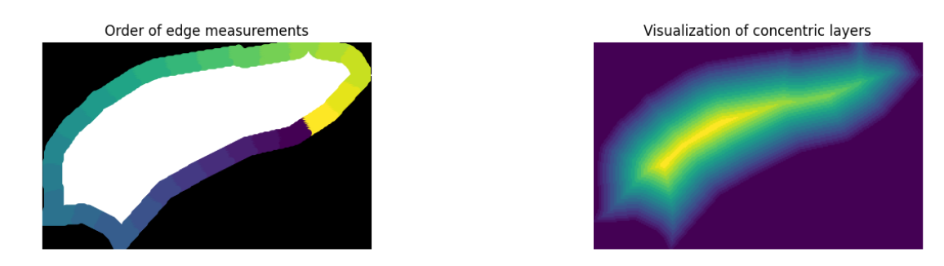
Quantification of edge and radial distributions
One technical aspect of the edge distribution is that choosing the beginning (point 0 at x axis) is arbitrary. In the future we can link it to the general actin flow or any other biologically meaningful cell feature. For now, in the quantifications below, the 0 angle is defined as the region that is straight to the right from the center of gravity of a cell (here marked in dark violet). The edge distributions will be clockwise.
For the radial distributions I will be quantifying signal in 20 equidistant layers starting from the edge (violet) of a cell and finishing in the center (yellow).

Slide 10
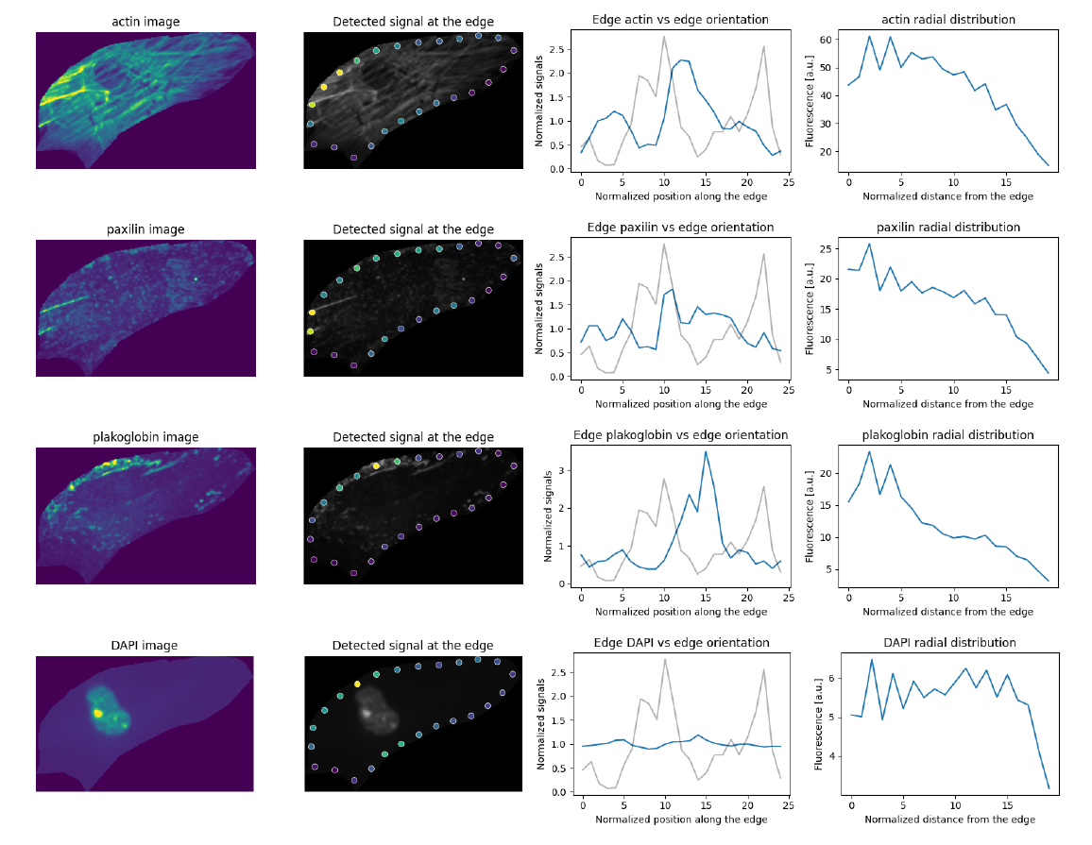
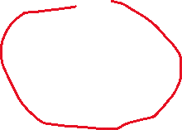
Cell 01
Please note, in this cell we capture plakoglobin localization on the cell edge parallel to the actin flow.

Slide 11
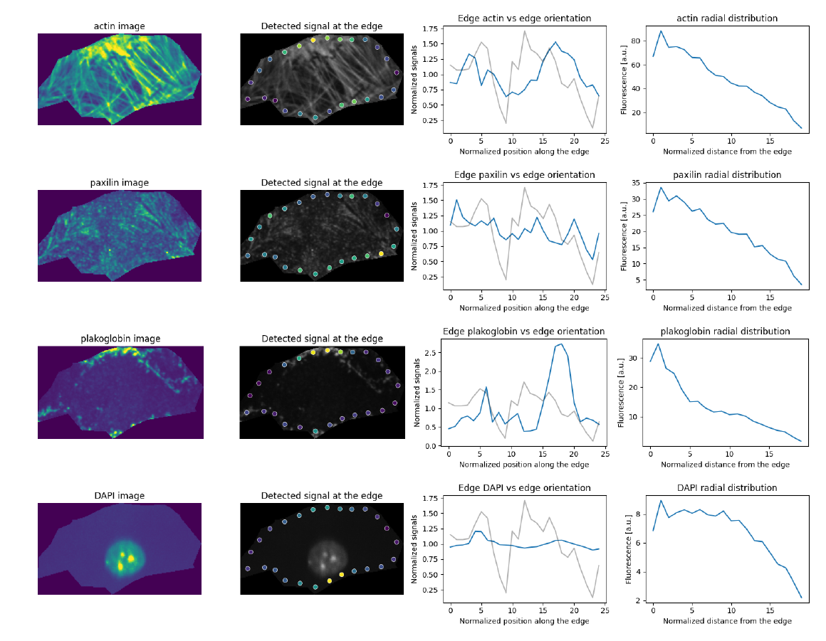
Cell 02

Slide 12
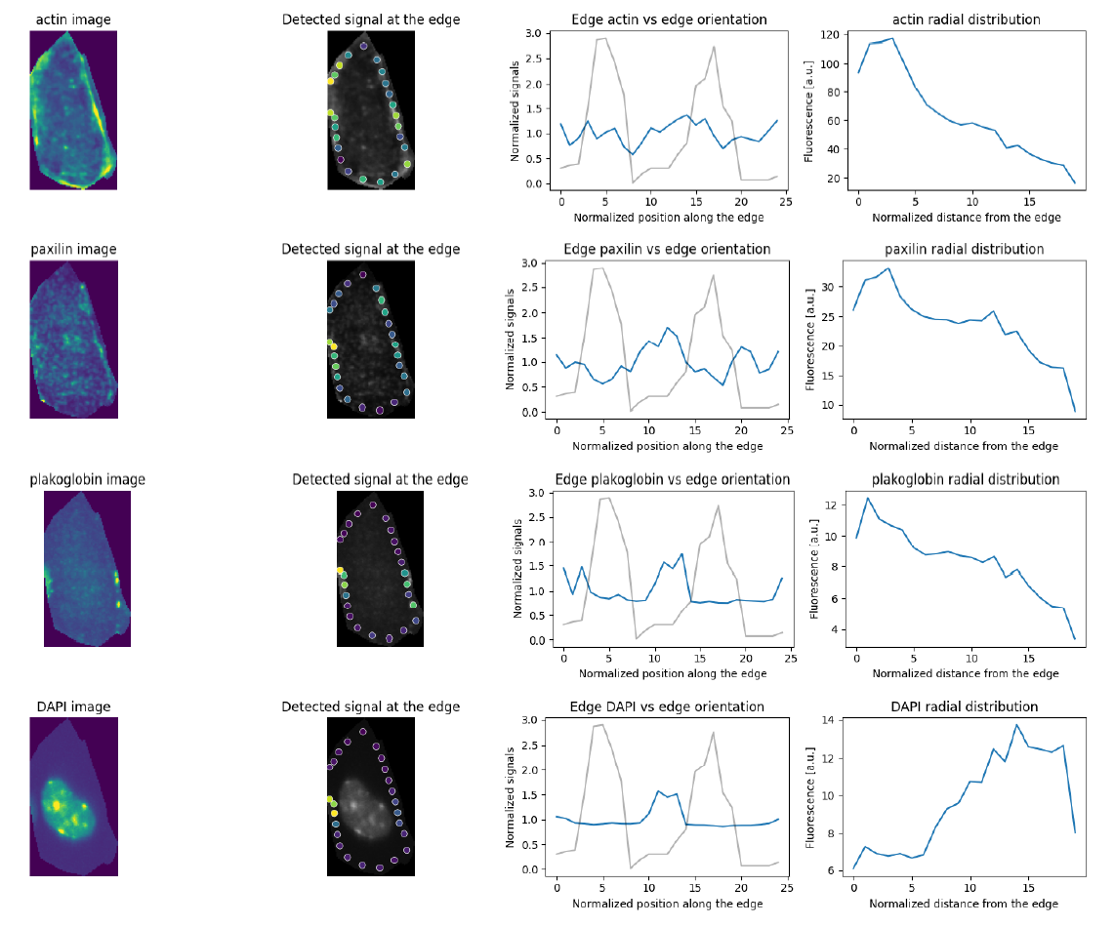
Cell 03

Slide 13
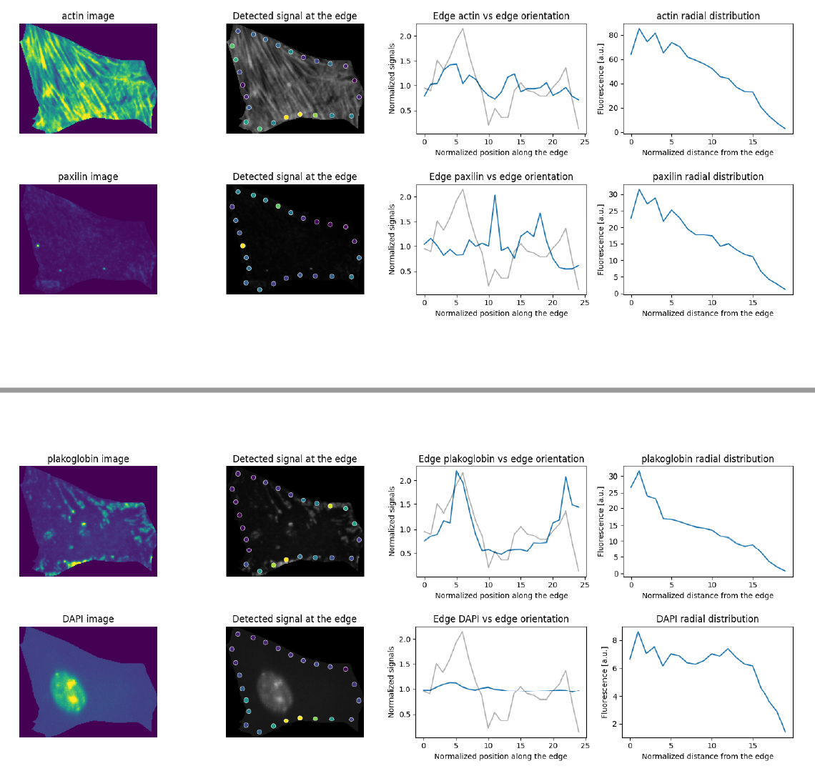
Cell 04

